Slide 1

UNIVERSITY OF TARTU
Petfinder Team
Notes:
Hello everyone and thanks for being here today! We are the Petfinder team, let me go through our agenda.

Slide 2

Today's Agenda
Who we are?
Brief about the project
Problem statement
Project
Result of our work
Encountered difficulties
What did we learn?
Notes:
The first step will be an intro about team members and our project.
Then the problem statement of the project.
Later, we are going to go through the solution process.
The final steps will be difficulties that we encountered and the wisdom that came with this process.

Slide 3



Who we are?
Kamil
Aliyev
Adil
Abdurrazaklı
Notes:
I am Kamil Aliyev and my companion for this project is Adil Abdurrazakli.
We are back-end developers with several years of experience.

Slide 4





Brief about the project
Titanic
On April 15, 1912, the widely considered “unsinkable” Titanic sank after colliding with an iceberg.
Unfortunately, there weren’t enough lifeboats for everyone on board, resulting in the death of 1502 out of 2224 passengers and crew.
Notes:
To be brief, our first project sunk like a titanic after the intermediate presentation session
so we decided to go with the titanic.
As you know in 1912 one of the biggest ships of that time sunk and so many people died in this tragedy

Slide 5
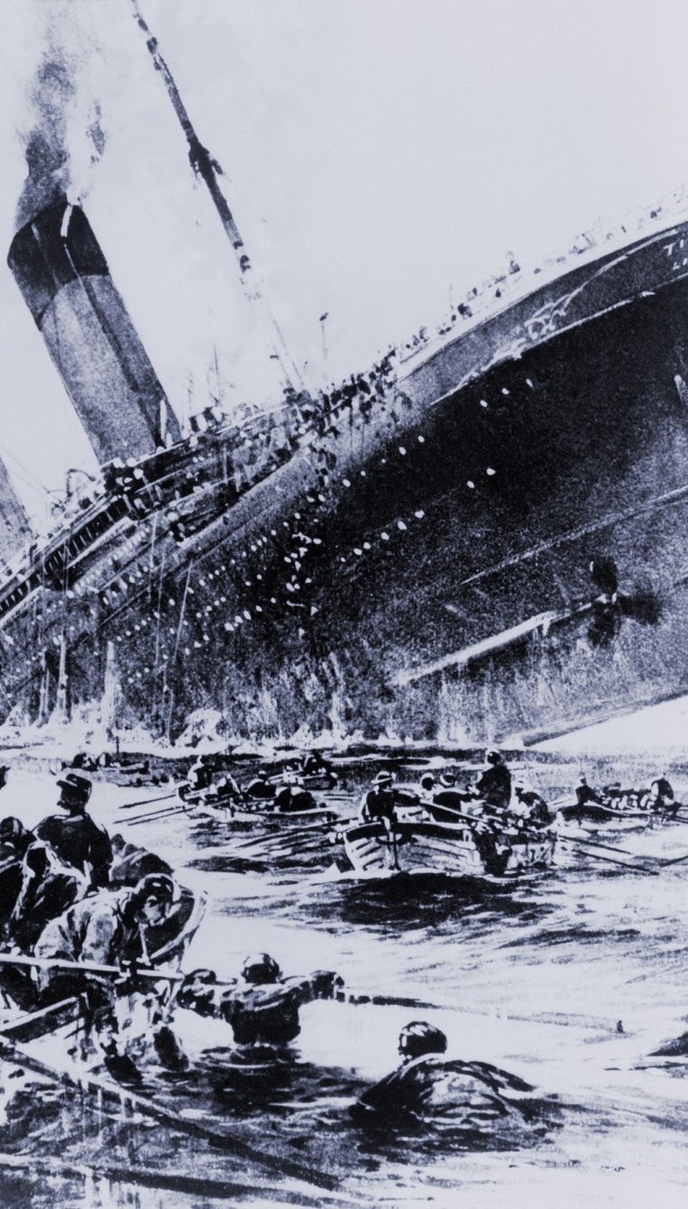
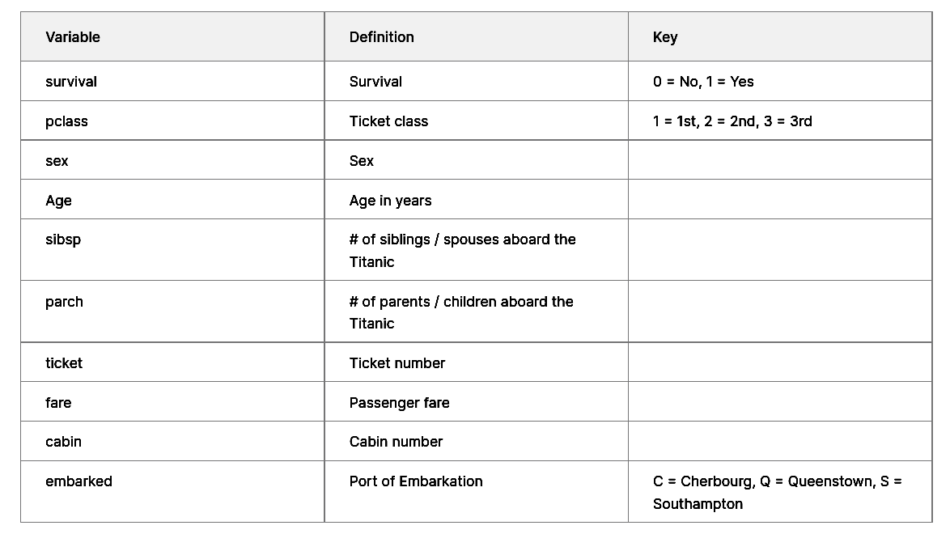
Problem Statement
“what sorts of people were more likely to survive?”

Slide 6

Project
Data Exploration
Feature Engineering
Data Processing
Ensemble Learning
Performance
Metrics
Models
step 1.
step 2.
step 3
step 4
step 5
step 6
histogram
pivot tables
correlation map
combination of columns
extraction of data
filling emty values
Random Forest Classifier
Logistic Regression
KNN
SVC
XGBClassifier
Feedforward NN
Soft voting
ROC
Classification Report
Notes:
So in the project first we did the data exploration and analysis then we divided train data into validation and train.
20% for validation
80% for the train to be honest
Then run the models. We had 6 models, 5 of them basic classifiers and the last one is a neural network with 3 dense layers.
Then we took best performing models for ensemble learning. Where we started with a hard voting ensemble but it was not so useful, so we switched to soft voting.
In soft voting, we used weights at first, but it didn't improve a lot.
As far as, I have limited time, I will give the most exciting things for each part.

Slide 7
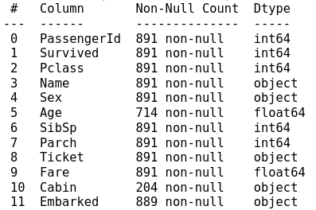
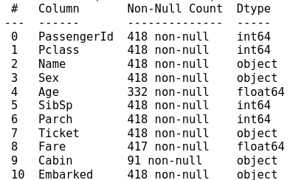
Data Exploration
Empty Values
Notes:
The first problem was with this null data in our train and test set.
Especially, for the age, because age was the second variable that has a huge impact on our results after the gender of passengers.

Slide 8
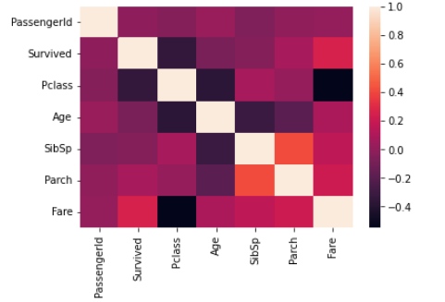
Data Exploration
Correlation map
Notes:
We built the correlation map by the help of seaborn,
and saw how the features are related to each other.

Slide 9
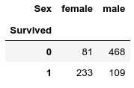
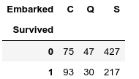
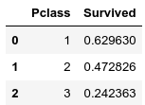
Data Exploration
Some interesting points
Notes:
There are some interesting pivot tables here too.
For example, which city you embarked has an impact on will you survive or not.
The first-class passengers, have more probability to survive (~15%)

Slide 10
Feature Engineering
Parent Children (Parch)
FamilyOnBoard
Sibling Spouse (SibSp)
Notes:
We saw these two variables from the beginning and the first thought was can we make one feature from this two variable?
And we did it and it improved the results a lit bit.

Slide 11
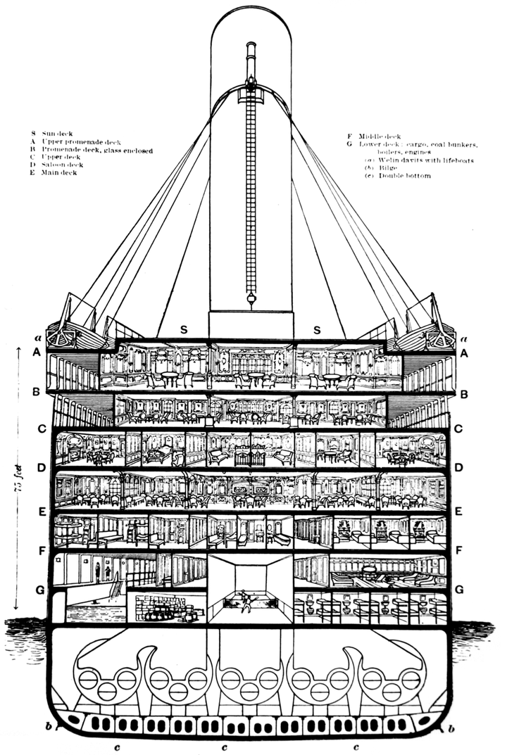
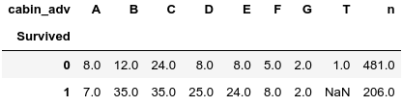
Feature Engineering
Cabin
C
cabin_adv
C 4
4
Notes:
Another exciting thing was with the cabin.
We were thinking about why it has the letter on it and after a little bit of research, we found out that each letter has a specific floor.
We used the lambda function to separate this data and saved the letter to cabin_adv
And here it is what we got.

Slide 12
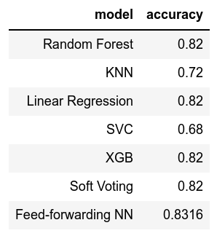
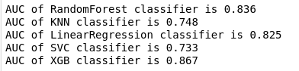
Models & Power Metrics
Notes:
This is our models and their metrics. The best working model for this problem was the Random forest algorithm.
Other models, like KNN started getting slightly overfitting.
I understood that the models are not so difficult mostly, the difficulty comes when you try to find the best parameters for the model and weights for voting algorithm

Slide 13
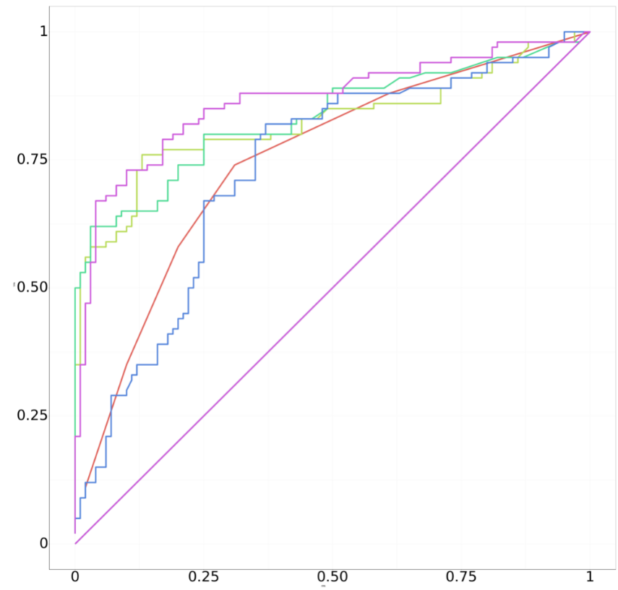
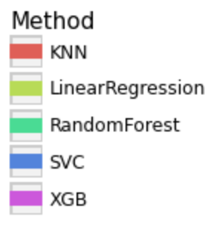
Models & Power Metrics
Notes:
The ROC curves for our models.
The best performing model for out problem was Random Forest with XGB
And obviously, they cover the biggest area under curve.

Slide 14

Result of our work?
Public score: 0.78229
In top: 21%
Notes:
We got the 0.78 public score
and we are in the top 21% of all contents members which is about 15k

Slide 15

Numpy not getting along with Pandas
pd.get_dummies( ) on seperate test and train dataframe leads to problem with categorical data
Filling empty values with only median data of one column makes models biased
Encountered difficulties
Notes:
The problem that took so much surprisingly was numpy and pandas integration
the other difficulty we had with pd.get_dummies() but I will show the problem in the next slide

Slide 16
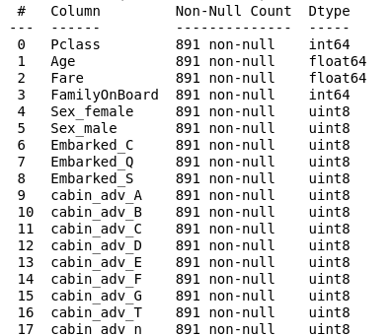
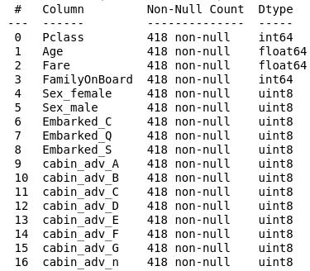
pd.get_dummies( )
train_x
test_x
Notes:
Get dummies is used for making categorical data numeric.
Do you see the 16th column of train data, we don't have it in test data. So it took about several hours to find out the problem.
I will use one hot encoder by scikit after this.

Slide 17
sklearn.preprocessing.OneHotEncoder
How to fill empty cells by grouping with other columns?
Models are just simple tools in any project. The difficult part starts while playing with weights and parameters of them.
What AI realistically can and cannot do?
What did we learned?

Slide 18
Do you have
any questions?

Slide 19
Project Link
here

